Slide 1


Project Content and Items
Esri Developer Summit
March 8–11, 2016 | Palm Springs, CA
Charles Macleod

Slide 2

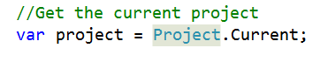
Project
ArcGIS Pro is based on “Project”
Closest Corollary in ArcMap or ArcScene is MXD or Scene respectively
There is no “hook” in Pro like ArcObjects
Many patterns involving content start with the current Project.
Archive format (zip)
Projects are self-contained. Consists of:
Project Content – Maps, Layouts, Scenes, Styles, Connections
Project Settings – Options, Preferences, Properties
Notes:
Most objects in Pro come from static classes, like Module and Project. Then can get Project.current

Slide 3
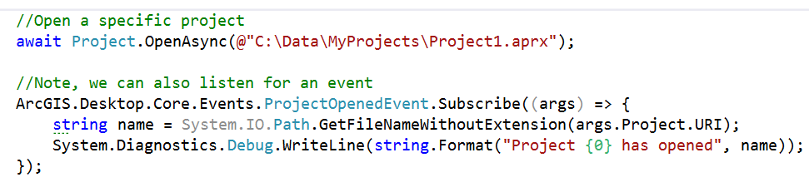
Project
To access the project instance
To open a specific project

Slide 4
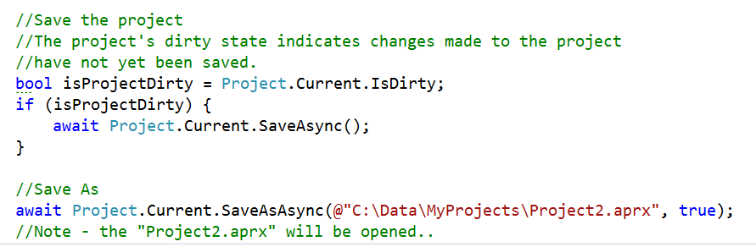
Project Instance
Save and Save As
Check the “IsDirty” flag
Note: ‘SaveAs’: The current project will be closed and the ‘Saved As’ project opened

Slide 5
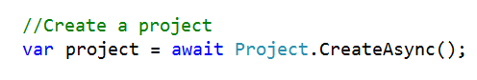
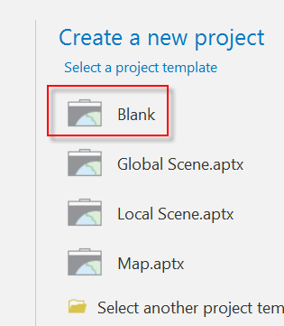
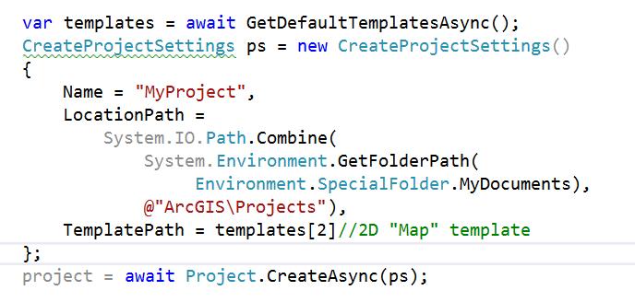
Project Instance
Create a Project
With no arguments, a default name is provided. The “Blank” template is used.
Using a specific template:
Notes:
Note: ProSnippets ‘Content’ contains the implementation of GetDefaultTemplatesAsync
https://github.com/ArcGIS/arcgis-pro-sdk/wiki/ProSnippets-content#method-to-return-the-default-template-folder
CreateProjectDemo

Slide 6
CreateProjectDemo
Notes:
Ppkx = package templates
Aptx = project templates
Extensions: Static class, key word this

Slide 7
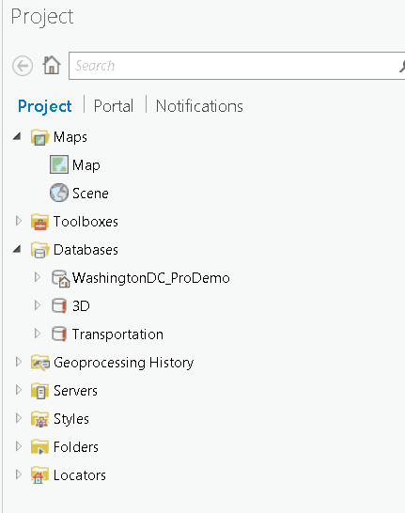
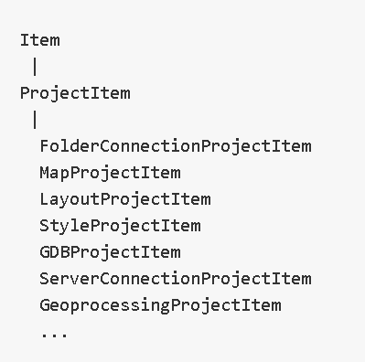
Project Content
Project Content is represented by ProjectItems
Derive from “Item”. Item is the basic type or “currency” of Pro.
Notes:
When enumerate project content, you enumerate items, not instantiate the objects.

Slide 8
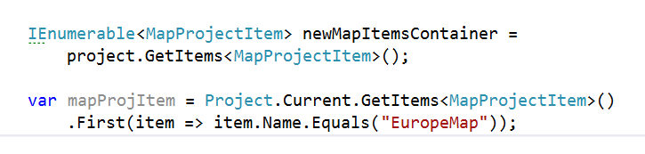
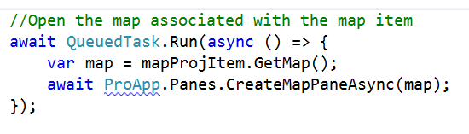
Project Content
Enumerate Project Content using Project.GetItems<T>. T is the type of ProjectItem.
Use LINQ-style queries to further filter the items

Slide 9
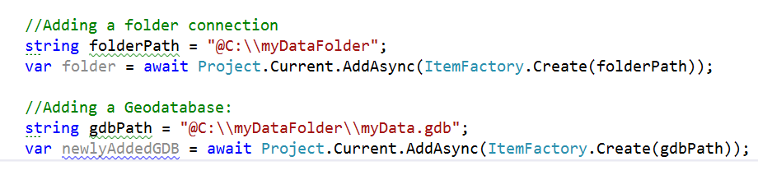
Project Content
Convert paths to Items using ItemFactory - Add to project using project.Add
Add to project using project.AddAsync. Check with project.CanAdd
public bool CanAdd(Item item) {
}
public Task<IEnumerable<ProjectItem>> AddAsync(Item item) {
}
Notes:
ItemFactory fills out all the metadata of folderPath

Slide 10
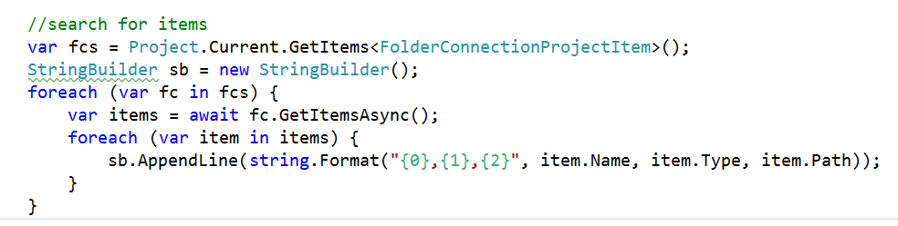
Project Content
Items are returned from Browse of Project Contents and Search of Disk and Portal(s)
Or use System.IO (but does not take advantage of project indexing)
//using System.IO
DirectoryInfo di = new DirectoryInfo(“…”);
FileInfo[] fis = di.GetFiles("*", SearchOption.AllDirectories);
foreach (FileInfo fi in fis) {
Item item = ItemFactory.Create(fi.FullName);
...
}
Notes:
ProjectItemsDemo

Slide 11
ProjectItemsDemo
Notes:
ProjectItemsDemo

Slide 12
Browse using Open Item Dialog
Similar to Microsoft.Win32.OpenFileDialog
A SaveItemDialog, similar to Microsoft.Win32.SaveFileDialog is also available
// Add a single item to a map
OpenItemDialog addDlg = new OpenItemDialog();
addDlg.Title = "Add To Map";
addDlg.InitialLocation = @"C:\Data\NewYork\Counties\Erie\Streets";
addDlg.Filter = ItemFilters.composite_addToMap;
if (addDlg.ShowDialog() ?? false) {
IEnumerable<Item> selectedItems = addDlg.Items;
foreach (Item selectedItem in selectedItems)
await Project.Current.AddAsync(selectedItem);
}

Slide 13
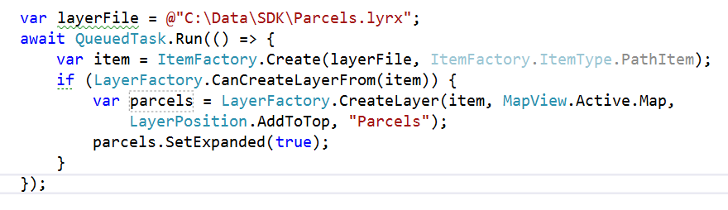
Model Object Factories
Many Items are not “Project Content Items”.
Layers, StandAlone Table, Symbol, etc.
Consume non-Project Content Items with Model Object Factories:
MapFactory, LayerFactory, StandAloneTableFactory, SymbolFactory, etc.
Note: (most) factory overloads also accept a path (as a System.Uri)
Notes:
The thing to remember is that not all Models are Project Content Items. For example, Layers, StandAlone tables, Symbols, etc.
They cannot be added to the project using Project.AddAsync.

Slide 14
Integration with Portal and Online
Portal Manager
Provides the connection information for the current portal
EsriHttpClient
Modelled after System.Net.WebRequest
Manages your security context on portal queries.
Acquires and Inserts the token into the REST call
Notes:
Handles tokens too.

Slide 15
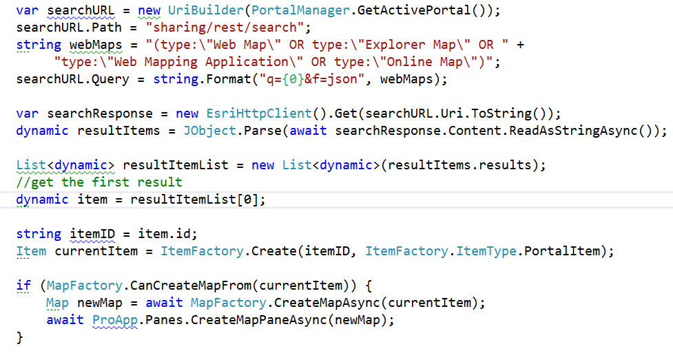
Project Content - Portal
At 1.1, 1.2 Use EsriHttpClient
See Sharing ProSnipppets and AddLayers Sample on arcgis-pro-sdk-community-samples
Notes:
EsriHttpClientDemo

Slide 16
Custom Project Settings - Persist Module Settings to the Project
Override Module.OnReadSettingsAsync and OnWriteSettingsAsync
Read: On project loaded (or on Module initialize if delay loaded)
Write: On project save
internal class Module1 : Module {
private static bool _doExecuteOnSelect = false;
protected override Task OnReadSettingsAsync(ModuleSettingsReader settings) {
//Your module settings are provided in the reader
_doExecuteOnSelect = Boolean.Parse(settings["EXEC_FLAG"].ToString());
return Task.FromResult(0);
}
protected override Task OnWriteSettingsAsync(ModuleSettingsWriter settings) {
//Persist custom settings as strings
settings.Add("EXEC_FLAG", _doExecuteOnSelect.ToString());
return Task.FromResult(0);
}
Notes:
Students - this will be available at 1.1.1

Slide 17
Project Content Item Context Menu
Defined in DAML same as all other UI Elements
Customize within your Module Config.daml
<updateModule refID="esri_mapping">
<menus>
<updateMenu refID="esri_mapping_mapContainerContextMenu">
<insertButton refID="ProjectItem_ContextMenu_Button1" separator="true" />
</updateMenu>
</menus>
</updateModule>
<insertModule id="ProjectItem_ContextMenu_Module" className="Module1" autoLoad="false" caption="Module1">
<controls>
<button id="ProjectItem_ContextMenu_Button1" ...>

Slide 18




